Slide 1

Idiographic Personality: A Methodological Perspective on Measuring and Modeling Individuals
Emorie D. Beck and Joshua J. Jackson
Washington University in St. Louis

Slide 2
Extraversion
Agreeableness
Conscientiousness
Neuroticism
Openness
Nomothetic
Notes:
For many years, the Big 5 have been the dominant taxonomy of between person individual differences.
And for good reason. The Big 5 have been linked to many important life outcomes, from academic and work performance to how long you’ll live.
This nomothetic approach describes how people differ from one another, but we miss a lot about single individuals with such a broad approach. A kind of classic example of this is that conscientiousness is a great way to screen job candidates, but once hired, it may not tell you much about the particular person who now works with you.

Slide 3
Extraversion
Agreeableness
Conscientiousness
Neuroticism
Openness
Idiographic
Notes:
Leading some to question whether the Big 5 holds for each person individually. Since the days of Gordon Allport, personality scientists have called for a person centered approach, but methods for implementing a person centered approach in a way that also *CLICK* maps onto broad population level patterns have remained limited.
So the question of whether person-centered approaches that capture nuances of an individual outperform broad nomothetic measures also remains unclear.

Slide 4
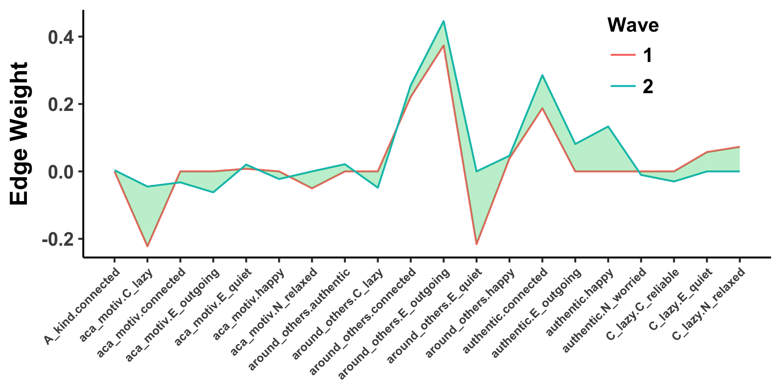
Promises | Challenges
Structure
Triggering Situations
Expectancies
States /
State
Expression
Re-
Actions
Process
Development

Slide 5
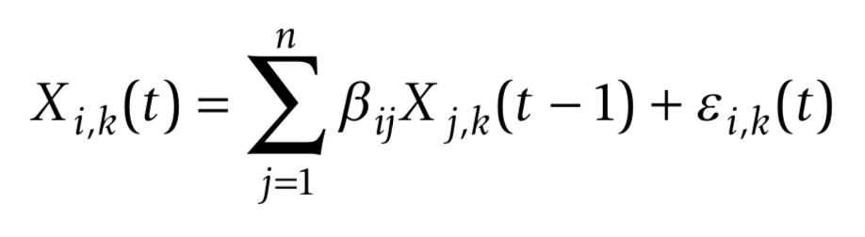
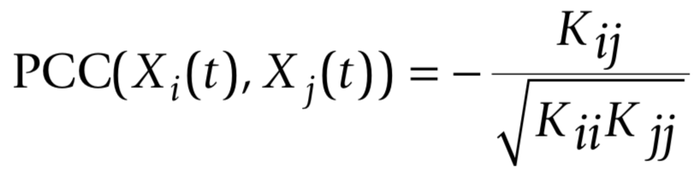
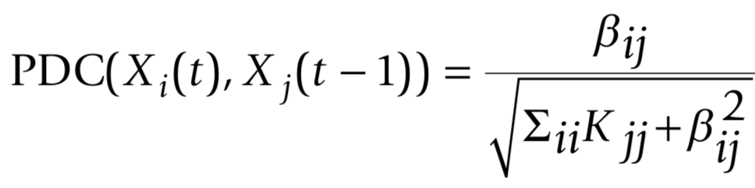
Idiographic Assessment: Graphical Autoregressive Models
Promises | Challenges
k = subjects
i = item
j = item
t = assessment point
K = concentration matrix
(inverse variance-covariance matrix)

Slide 6
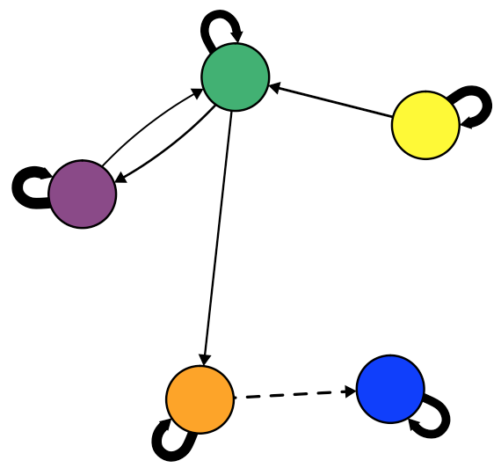
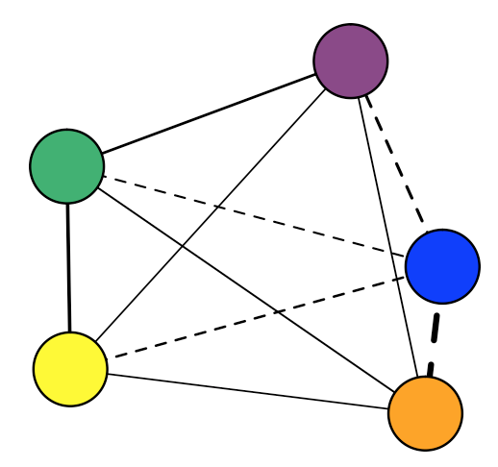
Promises | Challenges
Structure
Contemporaneous
Concurrent behaviors: While…
Temporal
Contingent behaviors: If…Then…
Within Time-Points:
X_{it}←→X_{jt}
Between Time-Points:
X_{it}→X_{i, t+1}

Slide 7
Promises | Challenges
Structure
Temporal
Contingent behaviors: If…Then…
X₁₁
X₁₂
X₁₃
. . .
X_{1j}
X₂₁
X₂₂
X_{2j}
X₃₁
X_{3j}
. . .
. . .
. . .
X_{i1}
. . .
X_{ij}
Between Time-Points:
X_{it}→X_{i, t+1}

Slide 8
Promises | Challenges
Structure
Contemporaneous
Concurrent behaviors: While…
1
X₁₂
X₁₃
. . .
X_{1j}
X₂₁
1
X_{2j}
X₃₁
X_{3j}
. . .
. . .
. . .
X_{i1}
. . .
1
Within Time-Points:
X_{it}←→X_{jt}

Slide 9
Promises | Challenges
Personality Processes
Triggering Situations
Expectancies
States /
State
Expression
Re-
Actions
Notes:
Could take this like “using a lasso technique or filtering method, we can see which situations, expectancies, states, and reactions are critical to a person and drop those that aren’t”
Could also talk about this in an interative sense, like “we could add studying and see how much more ariance is explained overall and how much less in other model terms”

Slide 10
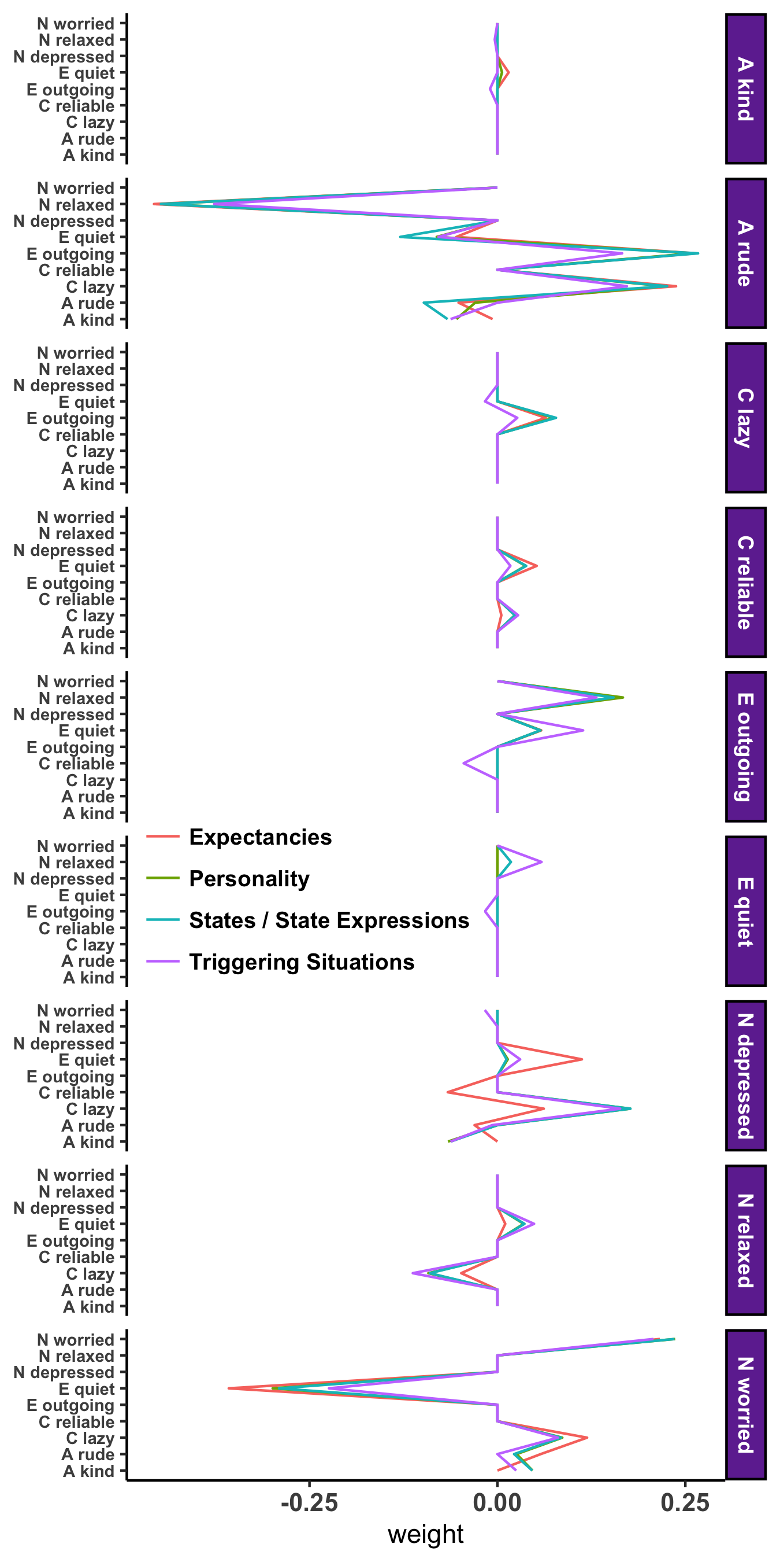
Promises | Challenges
Personality Processes
Personality
Triggering Situations
Expectancies
State / State Expressions

Slide 11
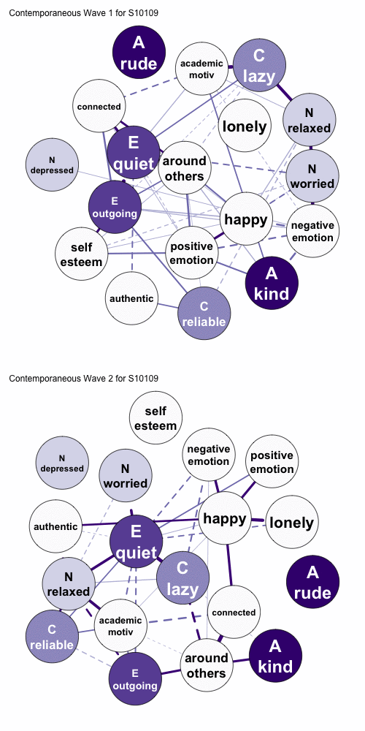
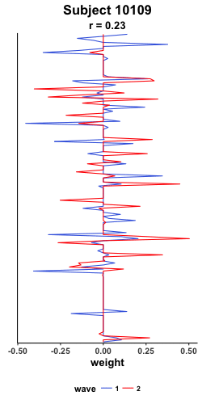
Promises | Challenges
Development

Slide 12
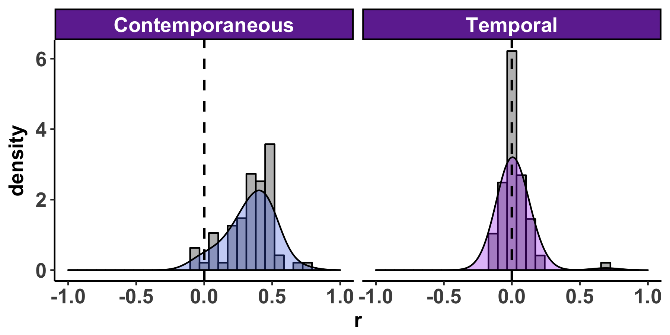
Promises | Challenges
Development

Slide 13
Promises | Challenges
Measurement Intervals
t | t – 1
3
2 | 3
4 | 2
2 | 4
4 | 2
3 | 4
3 | 3
3 | 3
2 | 3
1 | 2
 | 1
Worry
Rude
Quiet
Lazy
Academic Motivation
Positive Emotion

Slide 14
Promises | Challenges
Does cross-lagged behavioral consistency make sense?
Semester 1
Semester 2
8 AM | Wake up
9 AM | Class
10 AM | Study Break
11 AM | Class
12 PM | Class
1 PM | Work
2 PM | Work
8 AM | Class
9 AM | Class
10 AM | Work
11 AM | Work
12 PM | Break
1 PM | Break
2 PM | Class

Slide 15
Promises | Challenges
Consistency as an Individual Difference
Emorie in College
 | Monday | Tuesday | Wednesday | Thursday | Friday
6 AM | Work | Shower | Work | Shower | Work
7 AM | Work | Work | Work | Work | Work
8 AM | Work | Work | Work | Work | Work
9 AM | Shower | Class | Shower | Class | Shower
10 AM | Class | Class | Class | Class | Class
11 AM | Study | Study | Study | Study | Study
12 PM | Study | Study | Study | Study | Study

Slide 16
Promises | Challenges
Consistency as an Individual Difference
Emorie’s Best Friend in College
 | Monday | Tuesday | Wednesday | Thursday | Friday
6 AM | ????? | ????? | ????? | ????? | ?????
7 AM | ????? | ????? | ????? | ????? | ?????
8 AM | ????? | ????? | ????? | ????? | ?????
9 AM | ????? | ????? | ????? | ????? | ?????
10 AM | ????? | ????? | ????? | ????? | ?????
11 AM | ????? | ????? | ????? | ????? | ?????
12 PM | ????? | ????? | ????? | ????? | ?????

Slide 17
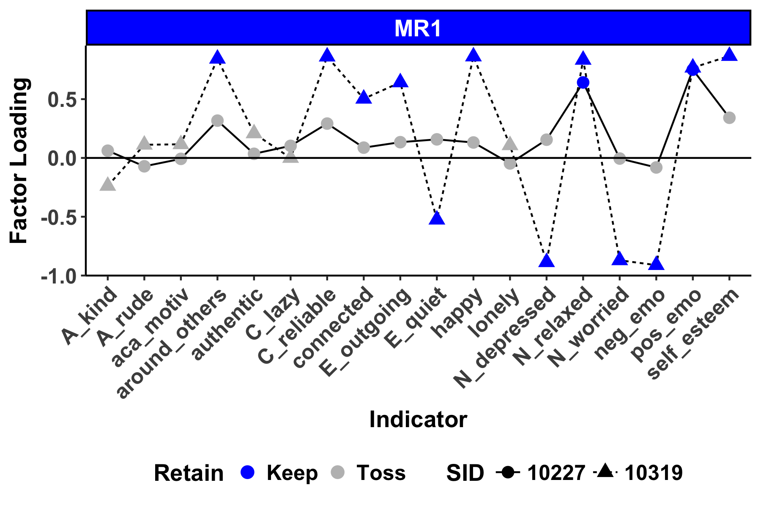
Promises | Challenges
Scale Development in ESM

Slide 18

Promises | Challenges
Scale Development in ESM

Slide 19
Promises | Challenges
Where do we go from here?
Measurement
Methodology
Modeling
Idiographic Tailoring
Planned Missing Data Designs
Sparse Modeling Techniques
Longitudinal Assessments
Incorporating additional dynamic measures
Intervention Studies

